Slide 1
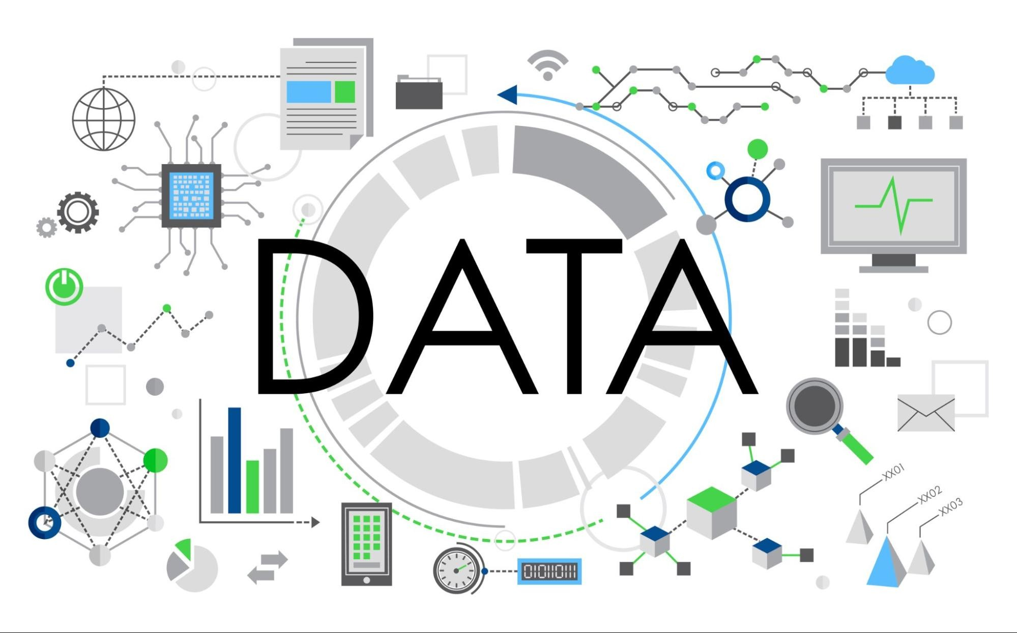
Introduction to the Data Lake
Lead by : PRITAM JAGDALE

Slide 2

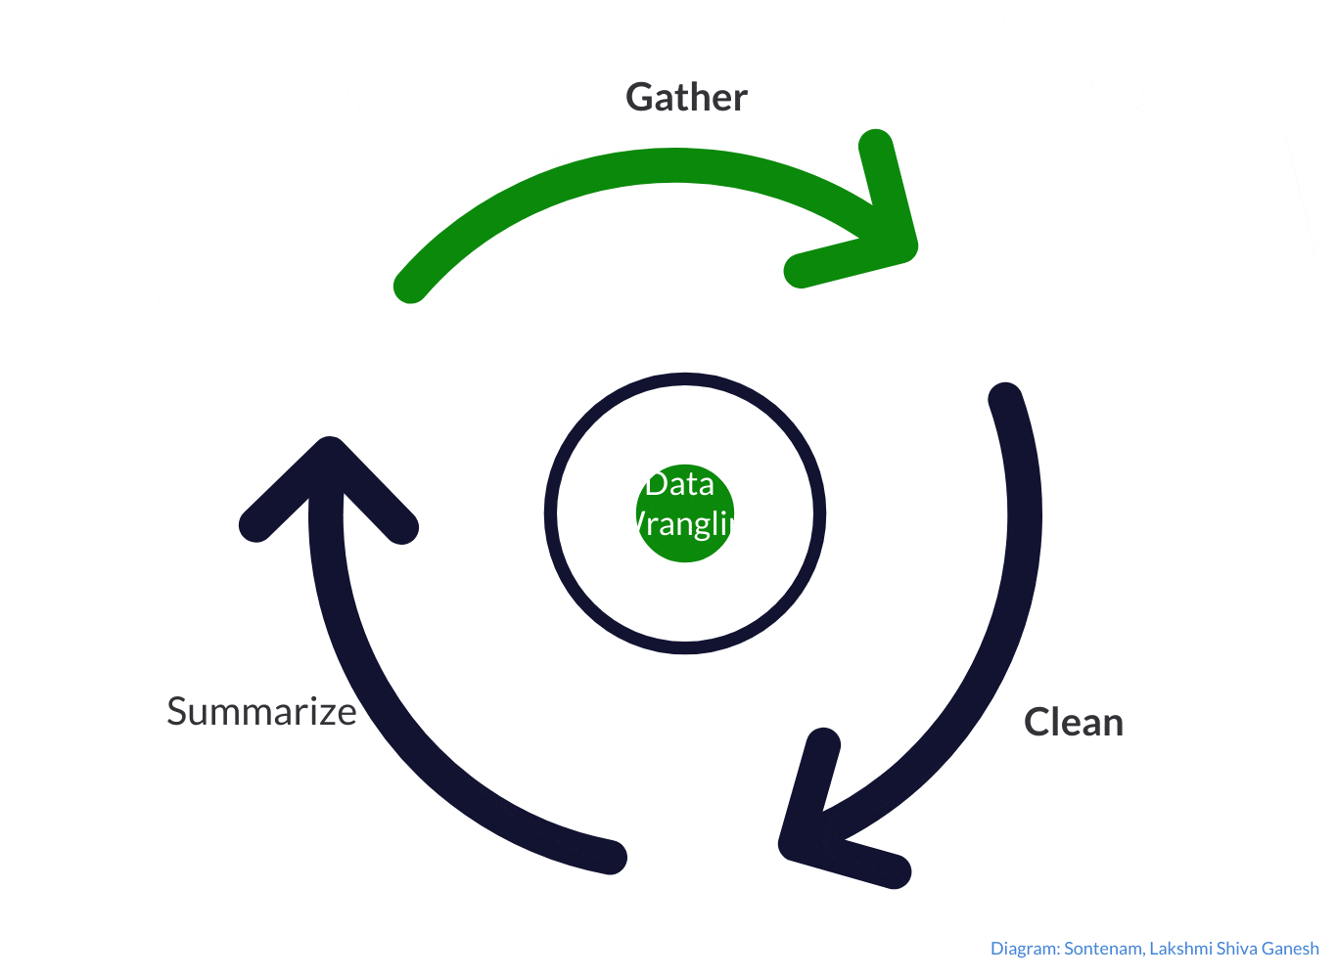
What is a Data Lake?
A data lake is a centralized repository designed to store, process, and secure vast amounts of data in its native format, accommodating structured, semi-structured, and unstructured data.
Key Features of Data Lakes
Storage Capability
Scalability
Diverse Data Type
Analytical Flexibility
Integration and Collaboration

Slide 3

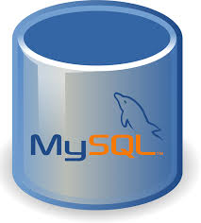
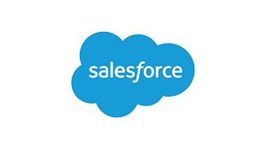
Existing Data Architecture
Business Application
TCL Cloud
Prod Env
Pentaho / Python
(ETL / ELT Tool)
TCL Cloud
Prod Env
CRM
LOS (SFDC)
Source DB on Cloud
Destination DB on Cloud
Structured, Semi-structured, and Unstructured data
Data Flow in Same Databases and same Instances

Slide 4
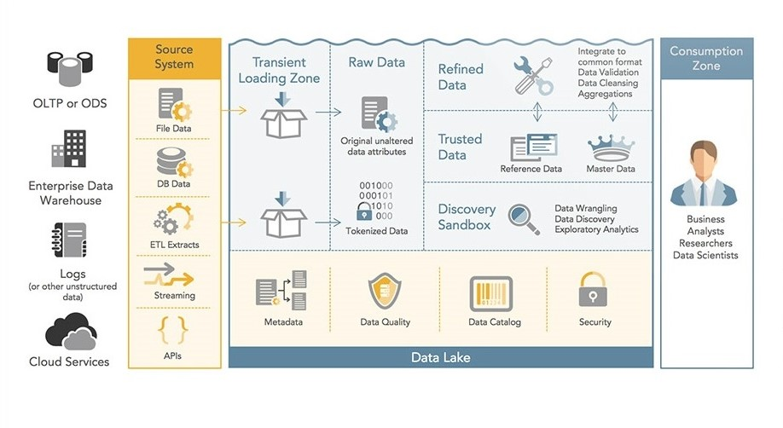
Data Lake
Architecture

Slide 5
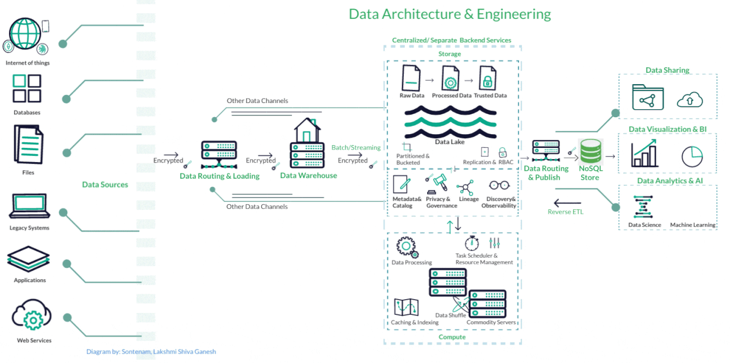

Slide 6




Benefits of a Data Lake
S
Scalability
Handling Large Volumes of Data
Horizontal Scalability Diverse
Data Ingestion
Cost-Effectiveness
C
Lower Storage Costs
Use of Commodity Hardware
Pay-as-You-Go Models
Reduced Data Duplication
F
Flexibility
Advanced Analytics
Schema-on-Read
Raw Data Storage
Schema-on-Read
AI/ML Applications and Insights
Big Data Analytics
Machine Learning Frameworks
Real-Time Analytics
A

Slide 7



Use CASES
Finance
01
Data Governance
03
Improved Compliance & Risk Management
Enhanced Forecasting Abilities
Fraud Detection and Prevention
Data Security
Data Quality
Compliance
Finance
Data Governance
USE CASES DATALAKE
Marketing
Operations & Reporting
Marketing
02
04
Operations & Reporting
360-Degree Customer Overview
Real-Time Campaign Adjustments
Enhanced Data Exploration.
Operational Efficiency
IoT Data Management
Real-Time Decision Making

Slide 8
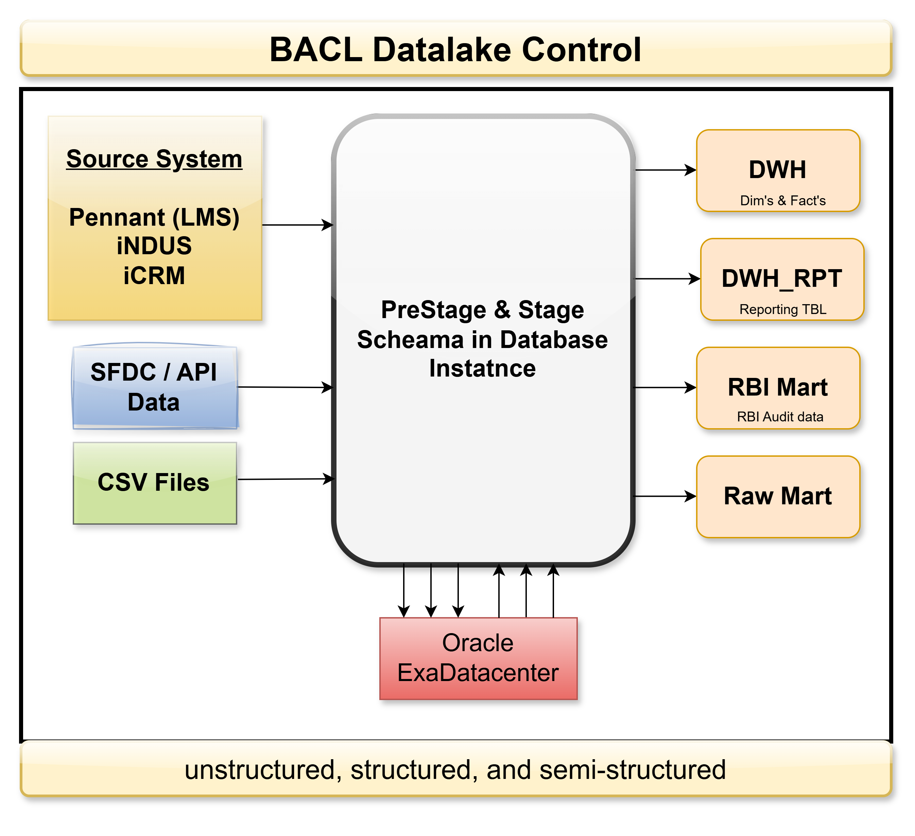
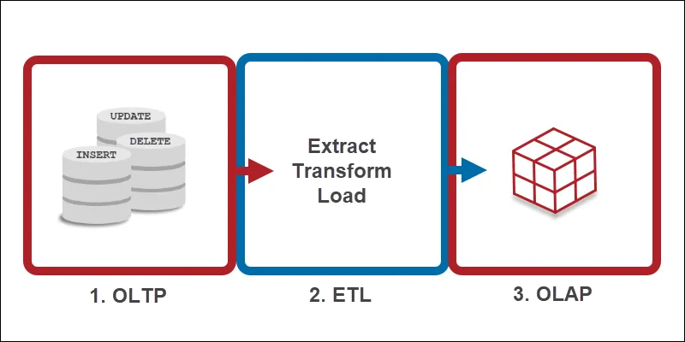
WIP - Architecture in Oracle Exa CC

Slide 9
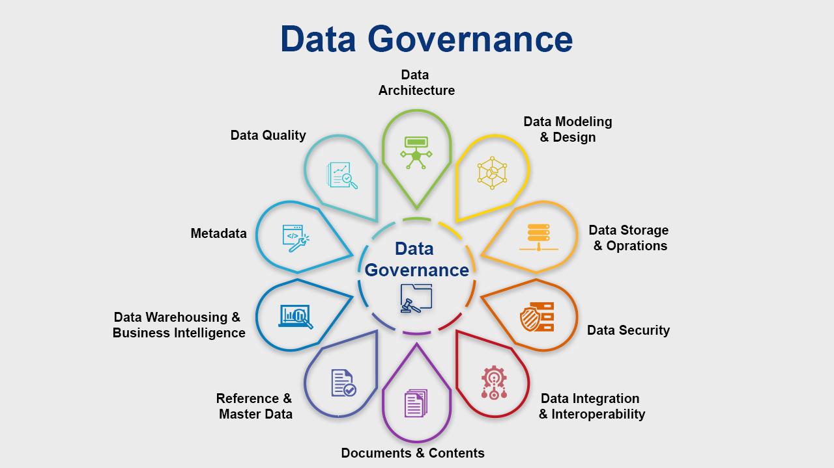

Slide 10
Benefits of a Data Lake
Scalability
Cost-Effectiveness
Handling Large Volumes of Data
Horizontal Scalability
Diverse Data Ingestion
Lower Storage Costs
Use of Commodity Hardware
Pay-as-You-Go Models
Reduced Data Duplication
Flexibility
Advanced Analytics
Schema-on-Read
Raw Data Storage
Schema-on-Read
AI/ML Applications and Insights
Big Data Analytics
Machine Learning Frameworks
Real-Time Analytics

Slide 11
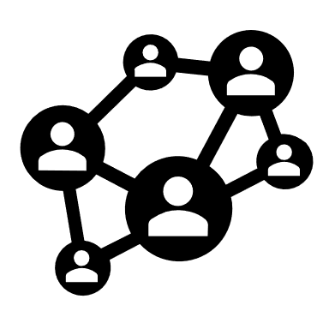
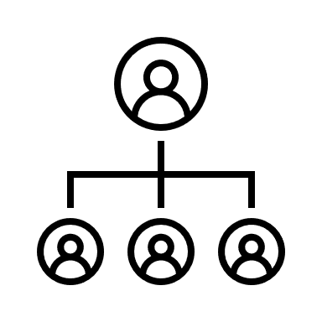



Use Cases
Marketing
Marketing
360-Degree Customer Overview
Real-Time Campaign Adjustments
Enhanced Data Exploration
Finance
Improved Compliance and Risk Management
Enhanced Forecasting Abilities
Fraud Detection and Prevention
Operations
Operational Efficiency
IoT Data Management
Real-Time Decision Making
Operations
Finance
Data
Lake
Data Analytics & AI / ML
Data Visualization & BI
Infosec / Data Governance,
Data Warehousing

Slide 12
Integration
How the data lake will integrate with existing systems
Key Integration Features
Schema-on-Read
Support for Diverse Data Types
Scalability and Cost-Effectiveness
Integration with Existing Tools
Challenges and Considerations
Data Governance
Complexity of Integration
Performance Optimization

Slide 13
Data Governance
Improved Data Quality
Security
Regulatory Compliance
Schema Accesses (Assess the Data Ecosystem)
Data sharing and Data Security
Enhanced Decision-Making
Develop Policies
Assign Roles and Responsibilities
Monitor and Measure
Continuous Improvement

Slide 14
Technology Stack
Cloud providers
Storage solutions
Data Processing Framework's
Data sharing tools and techniques

Slide 15
Key Features of Data Lakes
Storage Capability: Data lakes can handle large volumes of data, storing it as-is, which allows for the retention of raw data alongside processed data. This feature is crucial for analytics that require detailed source data.
Scalability: They are built to scale efficiently, making it possible to store data from various sources without sacrificing performance or fidelity. This scalability is essential for organizations dealing with growing data needs.
Diverse Data Types: Data lakes can accommodate various data formats, including images, audio, video, and documents, which are often critical for advanced analytics and machine learning applications.
Analytics Flexibility: Users can perform analytics using different tools and languages, such as SQL, Python, and R, without needing to move data to a separate analytics system. This democratizes access to data across different roles within an organization.
Integration and Collaboration: By centralizing data, data lakes help eliminate silos and improve collaboration among teams, allowing for a more comprehensive view of the data landscape.

